Slide 1

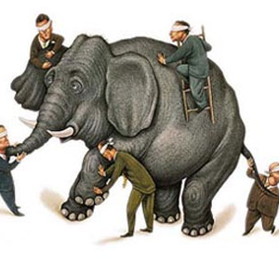
What is Cloud computing ?
Properties and characteristics

Slide 2
Cloud Computing
Definition:
Cloud computing can be deﬁned as a new style of computing in which dynamically scalable and often virtualized resources are provided as a services over the Internet.
Cloud computing has become a signiﬁcant technology trend, and many experts expect that cloud computing will reshape information technology (IT) processes and the IT marketplace.

Slide 3
Cloud Computing
An Internet cloud of resources can be either a centralized or a distributed computing system. The cloud applies parallel or distributed computing, or both.
Clouds can be built with physical or virtualized resources over large data centers that are centralized or distributed.
Some authors consider cloud computing to be a form of utility computing or service computing.

Slide 4
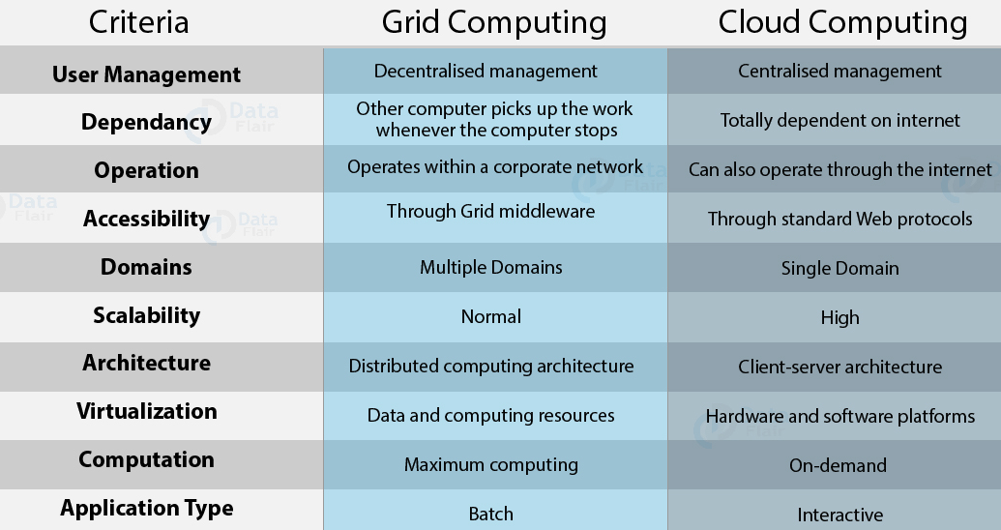
Grid vs Cloud
Notes:
The grid is an interconnected multidomain environment where each domain consists of computational, storage, and communication resources grouped together for business or administrative reasons. Each domain is independently administrated and is free to deploy different technologies.

Slide 5
Evolution of Computing
Centralized
1970~80
Main Frame Technology
Mobile
2010s
Transported Technology (Anytime, Anywhere)
Cloud UbiComp
2020s
Pervasive Ubiquitous Computing
Distributed
1970~80
Main Frame Technology
Internet
2000s
WWW Technologies
Cloud Computing (On Demand Metered Grid Usage)

Slide 6
Evolution of Cloud Computing
Grid Computing
Solving large problems with parallel computing
Utility Computing
Next-generation Internet Computing and data centre
Cloud Computing
SaaS
Network based subscription to applications
Offering computing resources as a metered service

Slide 7
Cloud Computing
Cloud computing is a model for enabling ubiquitous, convenient, on-demand network access to a shared pool of configurable computing resources.
It can be rapidly provisioned and released with minimal management effort.
It provides high level abstraction of computation and storage model.

Slide 8
Cont…
It has some essential characteristics, service models, and deployment models.
Cloud computing allows companies to avoid or minimize up-front IT infrastructure costs.
It relies on sharing of resources to achieve coherence and economies of scale, similar to a public utility.

Slide 9
Essential Characteristics
On-Demand Self Service:
A consumer can provision computing capabilities automatically without interaction with each service’s provider.
Heterogeneous Access:
Computer resources are available over the network and accessed through standard mechanisms that promote use by heterogeneous thin or thick client platforms.
Resource Pooling:
The provider’s computing resources are pooled to serve multiple consumers using a multi-tenant model.
Different physical and virtual resources dynamically assigned and reassigned according to consumer demand.
Measured Service:
Cloud systems automatically control and optimize resources used by leveraging a metering capability at some level of abstraction appropriate to the type of service.
Rapid elastics
Capabilities can be elastically provisioned and released (scale up/down based on the demand).

Slide 10

In Our Humble Opinion
Cloud computing is a paradigm of computing, a new way of thinking about IT industry but not any specific technology.
Central ideas
Utility Computing
SOA - Service Oriented Architecture
SLA - Service Level Agreement
Properties and characteristics
High scalability and elasticity
High availability and reliability
High manageability and interoperability
High accessibility and portability
High performance and optimization
Enabling techniques
Hardware virtualization
Parallelized and distributed computing
Web service

Slide 11

Central Ideas
Utility Computing SOA + SLA
Don’t tell me details!!
I DON’T CARE!!

Slide 12

Central Ideas
Utility Computing SOA + SLA
Perspective from user :
Users do not care about how the works are done
Instead, they only concern about what they can get
Users do not care about what the provider actually did
Instead, they only concern about their quality of service
Users do not want to own the physical infrastructure
Instead, they only want to pay as many as they used
What dose user really care ?
They only care about their “Service”

Slide 13
What Is Service?
Utility Computing SOA + SLA
A service encapsulates a software component that provides a set of coherent and related functionalities that can be reused and integrated into bigger and more complex applications.
Service is the endpoint of a connection.
Functionalities of service :
A service should be well-defined
A service should be self-contained
A service should not depend on the context or state of other services.

Slide 14
Characteristics of a Service
Boundaries are explicit:
A service-oriented application is generally composed of services that are spread across different domains, trust authorities, and execution environments.
Generally, crossing such boundaries is costly; therefore, service invocation is explicit by design and often uses message passing.
In a service-oriented computing environment the interaction with a service is explicit and the interface of a service is kept minimal to simplify the interaction
.

Slide 15
Characteristics of a Service(Cont..)
Services are autonomous:
Services are components that exist to offer functionality and are aggregated and coordinated to build more complex system.
They are not designed to be part of a specific system, but they can be integrated in several software systems, even at the same time.
Service orientation puts the focus on the design of the service as an autonomous component.
The notion of autonomy also affects the way services handle failures.
Services operate in an unknown environment and interact with third-party applications.
Therefore, minimal assumptions can be made concerning such environments: applications may fail without notice, messages can be malformed, and clients can be unauthorized.

Slide 16
Characteristics of a Service(Cont…)
Services share schema and contracts, not class or interface definitions:
Services are not expressed in terms of classes or interfaces, as happens in object-oriented systems, but they define themselves in terms of schemas and contracts.
A service advertises a contract describing the structure of messages it can send and/or receive and additional constraint—if any—on their ordering.
Because they are not expressed in terms of types and classes, services are more easily consumable in wider and heterogeneous environments.
At the same time, a service orientation requires that contracts and schema remain stable over time, since it would not be possible to propagate changes to all its possible clients.
To address this issue, contracts and schema are defined in a way that allows services to evolve without breaking already deployed code.
Technologies such as XML and SOAP provide the appropriate tools to support such features rather than class definition or an interface declaration

Slide 17
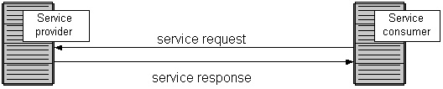
Service Oriented Architecture (SOA)
Utility Computing SOA + SLA
Definition
A service-oriented architecture is comprised of a number of different services that can be consumed by any number of clients.
There are two major roles within SOA: the service provider and the service consumer.
The only assumption made by either party is that communication takes the form of a well-defined and strictly enforced contract.
Provide a loosely-integrated suite of services that can be used within multiple business domains
Approach
Usually implemented by Web Service model

Slide 18
Cont….
The service provider is the maintainer of the service and the organization that makes available one or more services for others to use.
To advertise services, the provider can publish them in a registry, together with a service contract that specifies the nature of the service, how to use it, the requirements for the service, and the fees charged.
The service consumer can locate the service metadata in the registry and develop the required client components to bind and use the service.
Service providers and consumers can belong to different organization bodies or business domains.
It is very common in SOA-based computing systems that components play the roles of both service provider and service consumer.
Services might aggregate information and data retrieved from other services or create workflows of services to satisfy the request of a given service consumer. This practice is known as service orchestration, which more generally describes the automated arrangement, coordination, and management of complex computer systems, middleware, and services.
Another important interaction pattern is service choreography, which is the coordinated interaction of services without a single point of control.

Slide 19
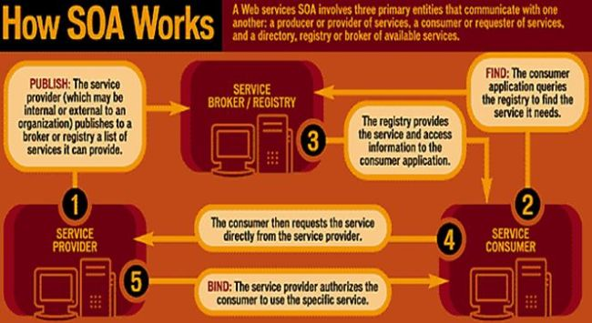

Slide 20

Quality Of Service
Utility Computing SOA + SLA
Original definition
QoS denotes the levels of performance, reliability, and availability offered by an application and by the platform or infrastructure that hosts it.
Now QoS becomes to a broad term that is used following areas :
Customer care evaluations
Technological evaluations

Slide 21
Quality Of Service
Utility Computing SOA + SLA
Customer care evaluations
QoS is usually measured in terms of issues that have a direct impact on the experience of the customer
Only issues that produce a negative effect on the goods and services received by the customer come under scrutiny
Technological evaluations
QoS has to do with the efficient operation of various systems
This can lead to adjusting procedures or adapting software programs and code to achieve the desired effect while making a more efficient use of available resources

Slide 22

Service Level Agreement
Utility Computing SOA + SLA
Definition
A service-level agreement (SLA) is a contract between a service provider and a customer that specifies, usually in measurable terms (QoS), what services the service provider will furnish
Common content in contract
Performance guarantee metrics
Up-time and down-time ratio
System throughput
Response time
Problem management detail
Penalties for non-performance
Documented security capabilities

Slide 23
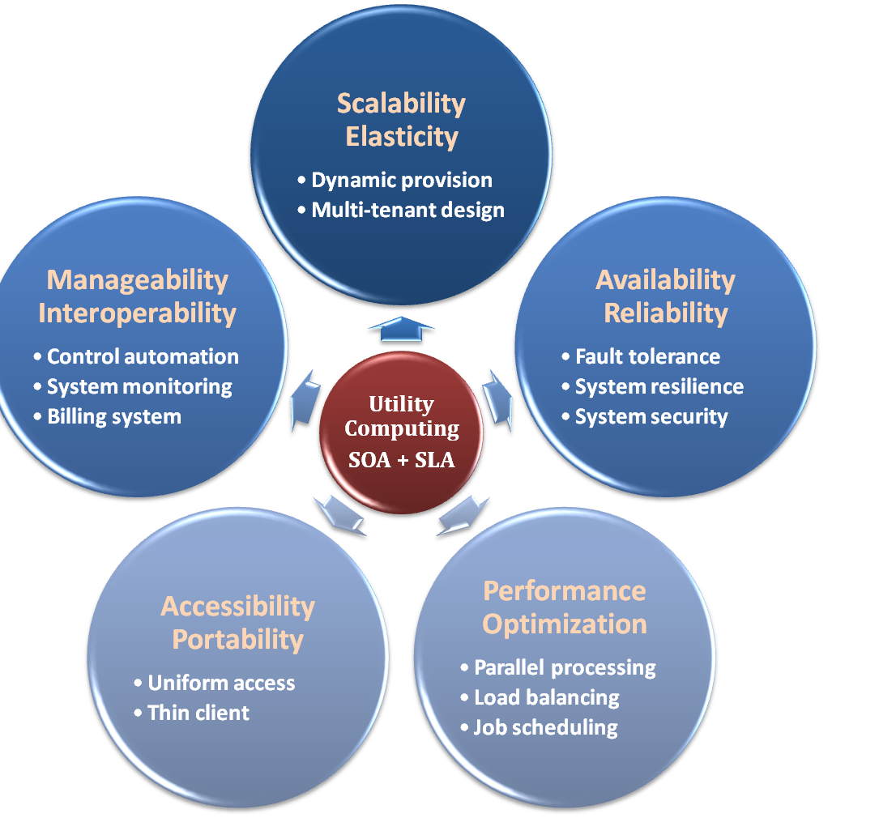

Properties and Characteristics

Slide 24
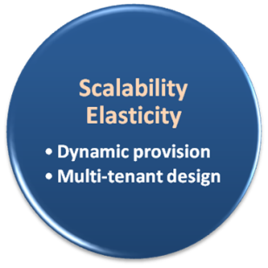

Scalability & Elasticity
Give me the world without limitation!!

Slide 25

Scalability & Elasticity
What is scalability ?
A desirable property of a system, a network, or a process, which indicates its ability to either handle growing amounts of work in a graceful manner or to be readily enlarged.
What is elasticity ?
In cloud computing, elasticity is defined as "the degree to which a system is able to adapt to workload changes by provisioning and de-provisioning resources in an autonomic manner, such that at each point in time the available resources match the current demand as closely as possible"

Slide 26
Multi-tenant Design
What is multi-tenant design ?
Multi-tenant refers to a principle in software architecture where a single instance of the software runs on a server, serving multiple client organizations.
With a multi-tenant architecture, a software application is designed to virtually partition its data and configuration thus each client organization works with a customized virtual application instance.
Client oriented requirements :
Customization
Multi-tenant applications are typically required to provide a high degree of customization to support each target organization's needs.
Quality of service
Multi-tenant applications are expected to provide adequate levels of security and robustness.

Slide 27
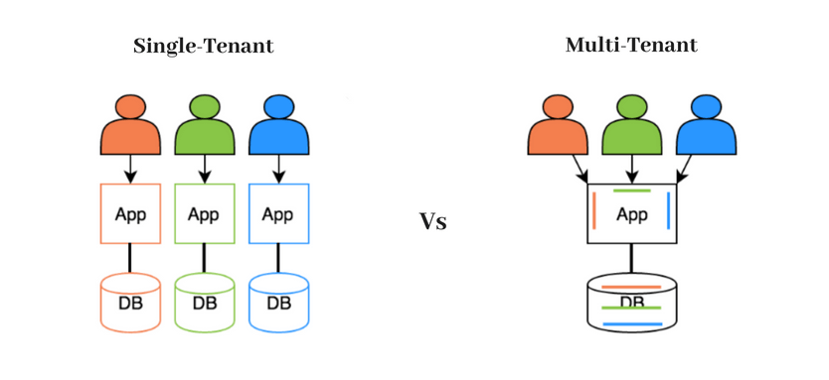

Slide 28
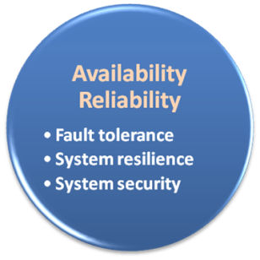

Availability & Reliability
Data Never Loss Machine Never Fail

Slide 29
Availability & Reliability
What is availability ?
The degree to which a system, subsystem, or equipment is in a specified operable and committable state at the start of a mission, when the mission is called for at an unknown time.
Cloud system usually require high availability
Ex. “Five Nines” system would statistically provide 99.999% availability
What is reliability ?
The ability of a system or component to perform its required functions under stated conditions for a specified period of time.
But how to achieve these properties ?
Fault tolerance system
Require system resilience
Reliable system security

Slide 30
Fault Tolerance
What is fault tolerant system ?
Fault-tolerance is the property that enables a system to continue operating properly in the event of the failure of some of its components.
If its operating quality decreases at all, the decrease is proportional to the severity of the failure, as compared to a naively-designed system in which even a small failure can cause total breakdown.
Three basic characteristics :
No single point of failure
Fault detection and isolation to the failing component
Fault containment to prevent propagation of the failure

Slide 31

Fault Tolerance
Single Point Of Failure (SPOF)
A part of a system which, if it fails, will stop the entire system from working.
The assessment of a potentially single location of failure identifies the critical components of a complex system that would provoke a total systems failure in case of malfunction.
Preventing single point of failure
If a system experiences a failure, it must continue to operate without interruption during the repair process.

Slide 32

Fault Tolerance
Fault Detection and Isolation (FDI)
A subfield of control engineering which concerns itself with monitoring a system, identifying when a fault has occurred and pinpoint the type of fault and its location.
Isolate failing component
When a failure occurs, the system must be able to isolate the failure to the offending component.

Slide 33
Fault Tolerance
Fault Containment
Some failure mechanisms can cause a system to fail by propagating the failure to the rest of the system.
Mechanisms that isolate a rogue transmitter or failing component to protect the system are required.

Slide 34
System Resilience
What is resilience ?
Resilience is the ability to provide and maintain an acceptable level of service in the face of faults and challenges to normal operation.
Resiliency pertains to the system's ability to return to its original state after encountering trouble. In other words, if a risk event knocks a system offline, a highly resilient system will return back to work and function as planned as soon as possible.
Some risk events
If power is lost at a plant for two days, can our system recover ?
If a key service is lost because a database corruption, can the business recover ?

Slide 35

System Resilience
Disaster Recovery
Disaster recovery is the process, policies and procedures related to preparing for recovery or continuation of technology infrastructure critical to an organization after a natural or human-induced disaster.
Some common strategies :
Backup
Make data off-site at regular interval
Replicate data to an off-site location
Replicate whole system
Preparing
Local mirror systems
Uninterruptible Power Supply (UPS)

Slide 36
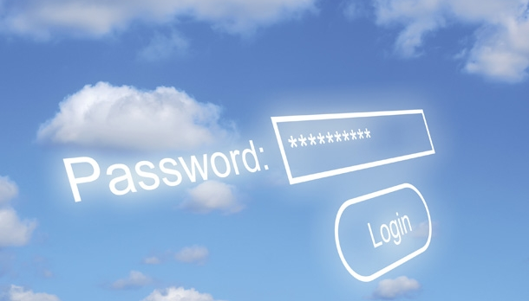
System Security
Security issue in Cloud Computing :
Cloud security is an evolving sub-domain of computer security, network security, and, more broadly, information security.
It refers to a broad set of policies, technologies, and controls deployed to protect data, applications, and the associated infrastructure of cloud computing.

Slide 37
System Security
Important security and privacy issues :
Data Protection
To be considered protected, data from one customer must be properly segregated from that of another.
Identity Management
Every enterprise will have its own identity management system to control access to information and computing resources.
Application Security
Cloud providers should ensure that applications available as a service via the cloud are secure.
Privacy
Providers ensure that all critical data are masked and that only authorized users have access to data in its entirety.
Notes:
Application security is the process of developing, adding, and testing security features within applications to prevent security vulnerabilities against threats such as unauthorized access and modification.

Slide 38
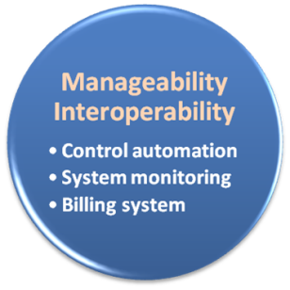

Manageability & Interoperability
I Want Full Control !!

Slide 39
Manageability & Interoperability
What is manageability ?
It means manage entire cloud system.
System management in Cloud Computing is much more dependent on overall network and offered service management
What is interoperability ?
Interoperability is a property of a product or system to work with other products or systems, present or future, without any restricted access or implementation.
But how to achieve these properties ?
System control automation
System state monitoring

Slide 40
Control Automation
What is Autonomic Computing ?
An autonomic computing system would control the functioning of computer applications and systems without input from the user, in the same way that the autonomic nervous system regulates body systems without conscious input from the individual.
The goal of autonomic computing is to create systems that run themselves, capable of high-level functioning while keeping the system's complexity invisible to the user.

Slide 41
Functional Areas of Control Automation
Four functional areas :
Self-Configuration
Automatic configuration of components.
Self-Healing
Automatic discovery, and correction of faults.
Self-Optimization
Automatic monitoring and control of resources to ensure the optimal functioning with respect to the defined requirements.
Self-Protection
Proactive identification and protection from arbitrary attacks.

Slide 42

System Monitoring
What is system monitor ?
A System Monitor in systems engineering is a process within a distributed system for collecting and storing state data.
What should be monitored in the Cloud ?
Physical and virtual hardware state
Resource performance metrics
Network access patterns
System logs
Billing system

Slide 43

Billing System
Billing System in Cloud
Users pay as many as they used.
Cloud provider must first determine the list of service usage price.
Cloud provider have to record the resource or service usage of each user, and then charge users by these records.
How can cloud provider know users’ usage ?
Get those information by means of monitoring system.
Automatically calculate the total amount of money which user should pay.
And automatically request money from use’s banking account.

Slide 44
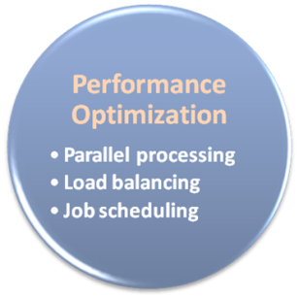

Performance & Optimization
High Performance Improvement

Slide 45
Performance & Optimization
Performance guarantees ??
As the cloud computing uses high computing resources, application performance should be guaranteed.
Cloud providers make use of powerful infrastructure or other underlining resources to build up a highly performed and highly optimized environment, and then deliver the complete services to cloud users.
But how to achieve this property ?
Parallel computing
Load balancing
Job scheduling

Slide 46
Parallel Processing
Parallel Processing
Parallel processing is a form of computation in which many calculations are carried out simultaneously, operating on the principle that large problems can often be divided into smaller ones, which are then solved concurrently.
Parallelism in different levels :
Bit level parallelism
Instruction level parallelism
Data level parallelism
Task level parallelism

Slide 47
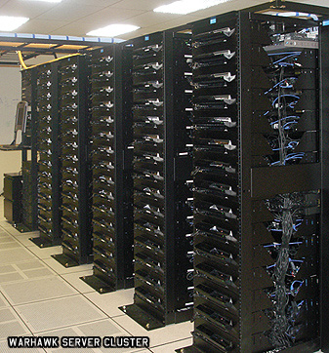
Parallel Processing
Hardware approaches
Multi-core computer
Symmetric multi-processor
General purpose graphic processing unit
Vector processor
Distributed computing
Cluster computing
Grid computing
Software approaches
Parallel programming language
Automatic parallelization

Slide 48

Load Balancing
What is load balancing ?
Load balancing is a technique to distribute workload evenly across two or more computers, network links, CPUs, hard drives, or other resources, in order to get optimal resource utilization, maximize throughput, minimize response time, and avoid overload.
Why should be load balanced ?
Improve resource utilization
Improve system performance
Improve energy efficiency
Unbalanced

Slide 49
Job Scheduling
What is job scheduler ?
A job scheduler is a software application that is in charge of unattended background executions, commonly known for historical reasons as batch processing.
What should be scheduled in Cloud ?
Computation intensive tasks
Dynamic growing and shrinking tasks
Tasks with complex processing dependency
How to approach ?
Use pre-defined workflow
System automatic configuration

Slide 50
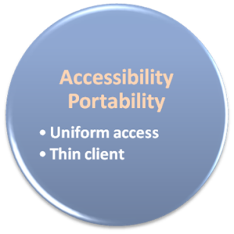

Accessibility & Portability
Anyone !
Anytime !
Anywhere !

Slide 51
Accessibility & Portability
What is accessibility ?
Accessibility is a general term used to describe the degree to which a product, device, service, or environment is accessible by as many people as possible.
What is service portability ?
Service portability is the ability to access services using any devices, anywhere, continuously with mobility support and dynamic adaptation to resource variations.
But how to achieve these properties ?
Uniform access
Thin client

Slide 52
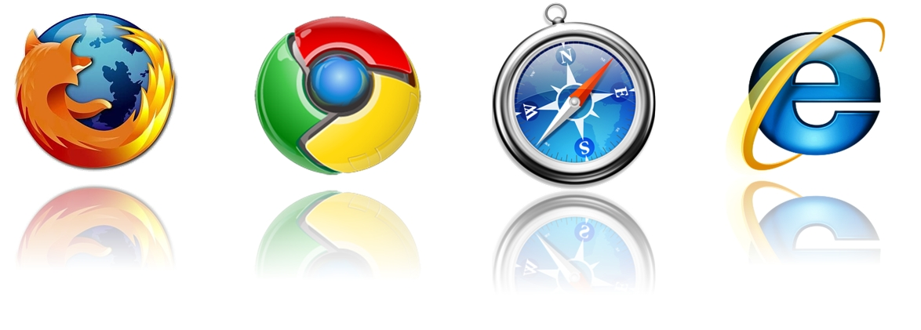
Uniform Access
How do users access cloud services ?
Cloud provider should provide their cloud service by means of widespread accessing media.
In other word, users from different operating systems or other accessing platforms should be able to directly be served.
Nowadays, web browser technique is one of the most widespread platform in almost any intelligent electronic devices.
Cloud service take this into concern, and delivery their services with web-based interface through the Internet.

Slide 53
Thin Client
What is thin client ?
Thin client is a computer or a computer program which depends heavily on some other computer to fulfill its traditional computational roles.
This stands in contrast to the traditional fat client, a computer designed to take on these roles by itself.
Advantage :
Cheap client hardware
While the cloud providers handle several client sessions at once, the clients can be made out of much cheaper hardware.
Diversity of end devices
End user can access cloud service via plenty of various electronic devices, which include mobile phones and smart TV.
Client simplicity
Client local system do not need complete operational functionalities.

Slide 54
NETFLIX---THE SYSTEM DESIGN
Netflix’s system design is complex and scalable and it is constantly evolving to meet the need of its growing user base.
The system is based on a microservices architecture, which allows Netflix to manage running both the heavy and lightweight workloads on the same infrastructure.
In 2008, Netflix migrates its entire infrastructure into cloud, a strategic move that revolutionized its scalability and performance.
The innovative system design that Netflix uses are given below:
Zulu—The Gatekeeper:
Zulu is the front door to handle all the requests that comes from users.
It enables dynamic routing, monitoring, security and more.
Hystrix--- The Safety Net:
Hystrix steps in when things go wrong.
It’s a fault tolerance library ensuring that Netflix stays up, even when some services falter.
Chaos Monkey----The Resilience Tester:
Chaos Monkey is a resilience tool.
It randomly terminates instances and inject faults in production to ensure that engineers design resilient services.

Slide 55
CONT….
ELB, Netty Server and Titus----The Server Masters:
These servers work in harmony to keep the servers running smoothly.
ELB handles load balancing across servers.
Netty Server deals with incoming and outgoing traffic
Titus is Netflix’s container management platform
Cassandra, Amazon EMR, Elasticsearch and Spark----The Data Wizards:
These four take care of data management and analytics.
Cassandra provides a distributed database system.
Amazon EMR handles big data use cases.
Elasticsearch powers real-time search.
Spark enables large-scale data processing.
Open Connect---The Content Deliverer:
Netflix’s very own CDN, Open Connect, ensures that the next episode of your favorite show loads instantly, anytime, anywhere, with zero buffering.
NETFLIX’S SYSTEM DESIGN IS A MASTERCLASS IN INNOVATION AND EFFICIENCY AND IT EVOLVES CONTINUOUSLY, EMBRACING NEW TECHNOLOGIES AND STRATEGIES TO MEET GROWING USER NEEDS AND EXPECTATIONS.

